Slide 1
Self-Employment Rules for SSI
Introduction to Self-Employment: Session 3
Work Incentive Support Center
Disability, Workplace, and Employment Support Practice Online Professional Programs

Slide 2

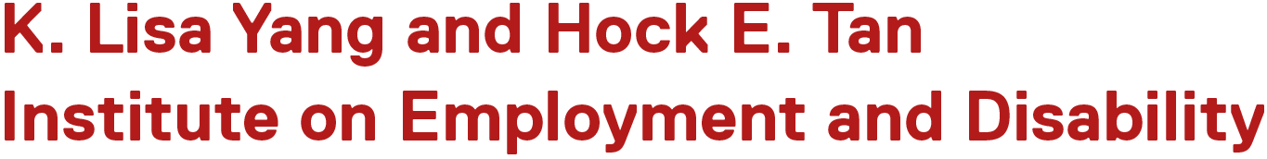
Information Screen
The Work Incentive Support Center (WISC) provides training, credentialing, and support to practitioners in the field of work incentive planning.
WISC is housed in the K. Lisa Yang and Hock E. Tan Institute on Employment and Disability. The institute, which is also known as the Yang-Tan Institute or YTI, is part of Cornell University’s ILR School.
Copyright © 2026 Cornell ILR. All rights reserved.

Slide 3
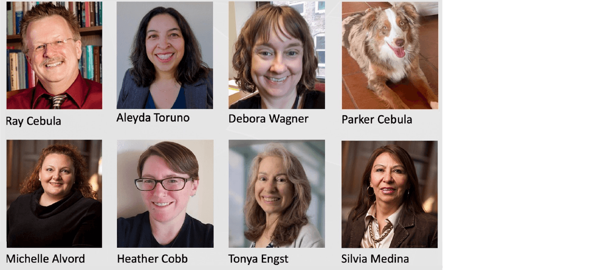
The WISC Team

Slide 4
Thank You
The contents of this course were developed under grant H421F240198 from the U.S. Department of Education (Department). The Department does not mandate or prescribe practices, models, or other activities described or discussed in this document. The contents of this course may contain examples of, adaptations of, and links to resources created and maintained by another public or private organization. The Department does not control or guarantee the accuracy, relevance, timeliness, or completeness of this outside information. The content of this course does not necessarily represent the policy of the Department. This publication is not intended to represent the views or policy of or be an endorsement of any views expressed or materials provided by any Federal agency. (EDGAR 75.620)
A special thank you to the National Disability Institute (NDI) for their leadership managing this grant.

Slide 5
Today’s Presentation
SSI Work Incentives for Self-Employment
Using PASS to Support Self-Employment
Resources for Self-Employment
  Achieving a Better Life Experience (ABLE) account
  Property Essential to Self-Support (PESS)

Slide 6

SSI Work Incentives for Self-Employment
All the same exclusions and deductions apply

Slide 7
The Impact of Self-Employment Income
SSI is “needs-based.” SSA reduces the SSI payment amount if the person has other income, including Net Earnings from Self-Employment (NESE).
To calculate a person’s monthly SSI payment, use the SSI Calculation Worksheet for Self-Employment. You’ll include the monthly NESE in the first line of Step 2.
To calculate total Countable Earned Income, subtract deductions and exclusions from the first line of Step 2.
Notes:
1. SSI is affected by
a) earned income only
b) unearned income only
c) both earned and unearned income
d) neither earned nor unearned income
Correct answer is c

Slide 8
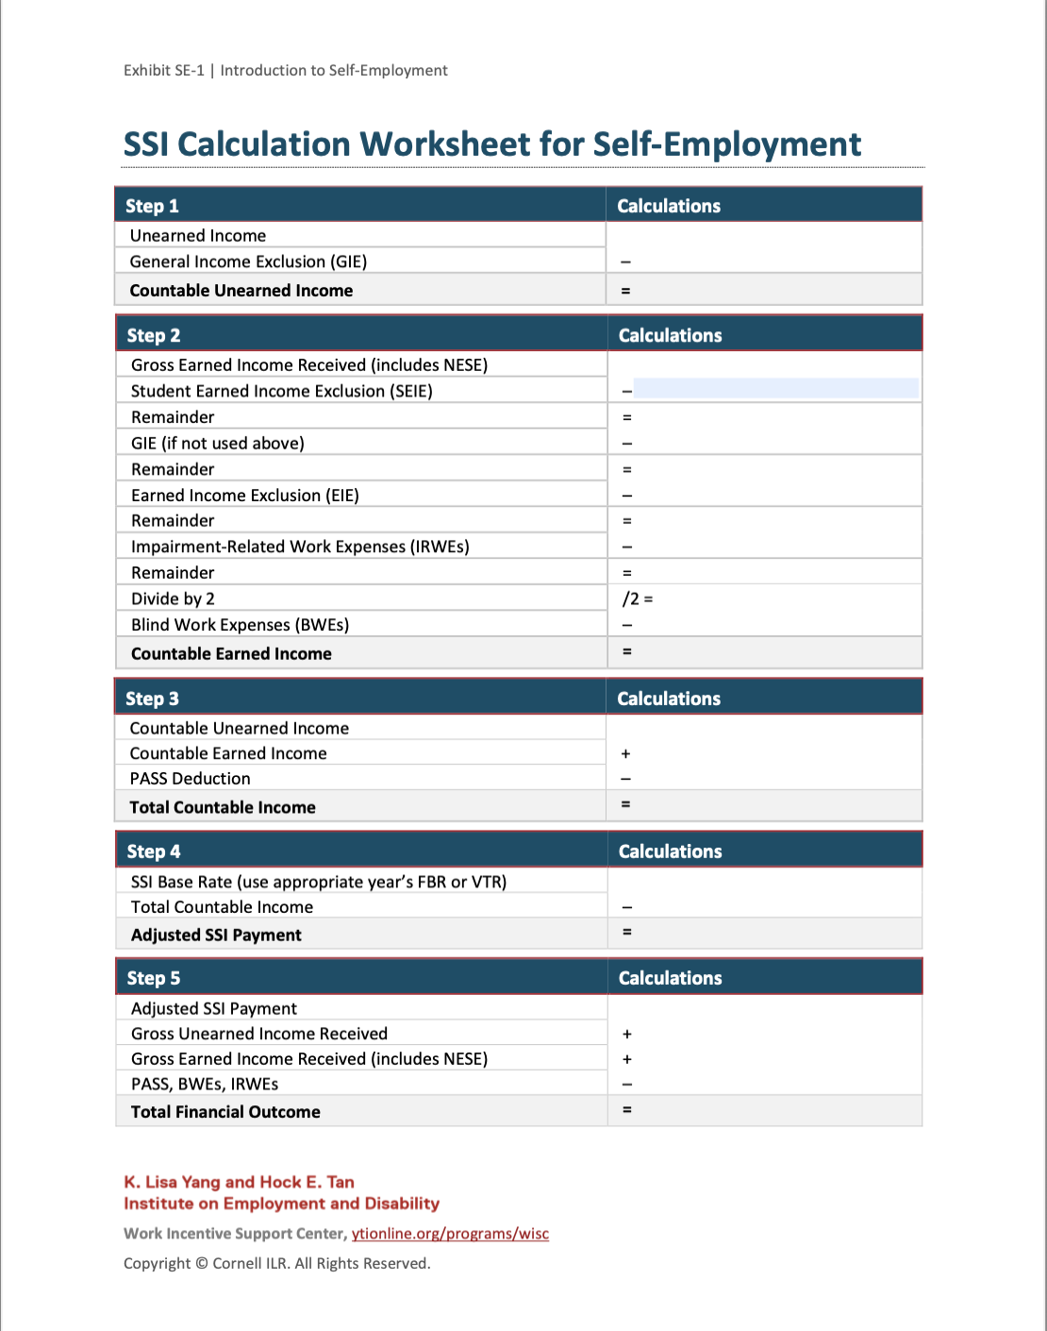
SSI Calculation Worksheet for Self-Employment
Use the SSI Calculation Worksheet for Self-Employment to estimate the monthly SSI payment.
An interactive web version is at ytionline.org/ssi-calculation-worksheet—in Step 2 and 5 of the web version, include the NESE in gross earned income.

Slide 9
SSI Work Incentives to Deduct from NESE
Student Earned Income Exclusion (SEIE) for individuals under age 22 who regularly attend school
General Income Exclusion if not applied to unearned income
Earned Income Exclusion of $65
Impairment-Related Work Expenses (IRWEs)
Earned Income Exclusion of one-half the remainder after the above-listed deductions
Blind Work Expenses (BWEs) for blind individuals on SSI only
Plan to Achieve Self-Support (PASS) deduction

Slide 10

Using PASS to Support Self-Employment
A powerful tool

Slide 11
About Plan to Achieve Self-Support (PASS)
With the PASS work incentive, a person with a disability can set aside income other than SSI and/or resources to be used to achieve specific work goals.
A PASS can be established to cover the costs of things like:
  Education
  Vocational training
  Starting a business
  Support services
  The options are almost limitless…
Notes:
OBJECTIVE 7:
IDENTIFY AND UTILIZE THE PLAN FOR ACHIEVING SELF-SUPPORT.
Begin this chapter by showing the “PASS” video produced by the Institute for Child Health Policy.
Following the video, explain that PASS is an SSI work incentive under which persons with disabilities can set aside income and/or resources to be used to achieve specific work goals. A PASS can be established to cover the costs of obtaining an education, receiving vocational training, starting a business, or purchasing support services which enable individuals to work and result in reduction/cessation of benefits (SSI/SSDI). These support services may include:
The purchase of coaching/job advocacy supports needed to obtain / maintain employment;
Vocational evaluation
The payment of transportation-related expenses;
The purchase of job-related equipment, uniforms, etc.;
The mechanism for allowing individuals or groups of individuals to purchase a business; and
Any other services/equipment needed to support individuals in a work-related manner.
Transition to next slide explaining the history of PASS and most recent program modifications.
Poll: If I inherited $100,000 from my uncle and was an SSD recipient, I could not place it in a PASS. True or False? On slide 5

Slide 12
How to Apply for PASS
Complete SSA Form-545-BK, which you can find online.
Submit the completed form to your local PASS specialist. Find your local specialist using Social Security’s Location of PASS Cadres web page.
If you do not already get SSI, if the PASS specialist believes they will likely approve the PASS, they will tell you to submit an SSI application.
The PASS specialist must approve the PASS application.
12
Notes:
To be approved by SSA, a PASS must be developed by
a vocational rehabilitation specialist
the beneficiary
the PASS Cadre at SSA
any or all of the above

Slide 13
Business Plan Resources
If a PASS application has a work goal of starting a business, a business plan must be submitted with the application.
These resources can help with developing a business plan:
  The Service Corps of Retired Executives (SCORE) can pair a PASS applicant with a mentor for free help developing a business plan. The mentor can also help with other planning and tasks related to starting a business.
  The Small Business Administration (SBA) also has free resources to help develop a business plan.
Remember
  The business plan should be submitted with the PASS application!

Slide 14
Separate Bank Account for PASS Funds
After the PASS application is approved, the applicant must set up a bank account to save PASS funds.
Deposit resources and/or income into the PASS bank account.
Do not put other funds in the PASS bank account.
Use money in the PASS bank account only to pay for goods and services approved in the PASS application.

Slide 15
PASS Example: Jaden
Jaden gets $857 per month in Childhood Disability Benefits (CDB) and $130 per month in SSI.
He paints as a hobby and wants to start a business to sell his paintings online and in galleries.
He worked with a SCORE mentor to develop a business plan.
Jaden submitted a PASS application to save $20,000 to purchase paint supplies and pay someone to help develop his website. Jaden’s PASS is approved.
Jaden saves $837 per month from his CDB in his PASS account. He keeps $20 per month from his CDB, and his SSI payment increases to $967 so he can still pay his living expenses.
State VR pays for Jaden to attend a local art school for 2 years. At the end of the 2 years, Jaden has saved just over $20,000 to start his business.

Slide 16
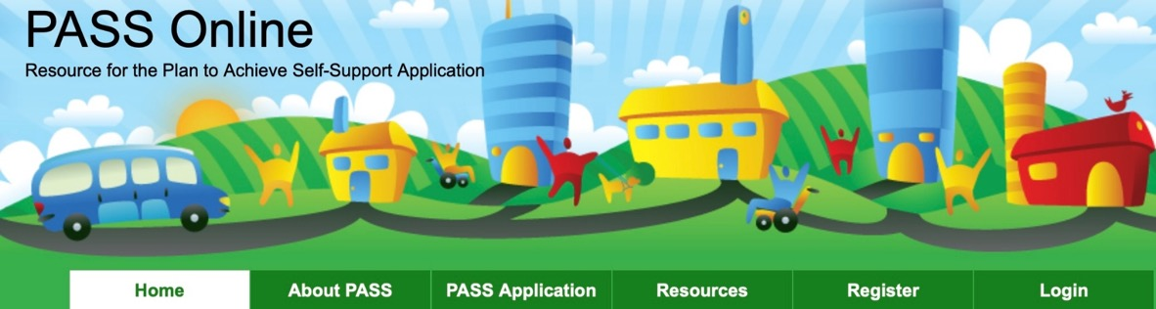
PASS Online
This website was created by the Yang-Tan Institute.
It helps people understand and apply for a PASS.
passonline.org

Slide 17

Resources for Self-Employment
Self-employment requires capital
Achieving a Better Life Experience (ABLE) Account
Property Essential to Self-Support (PESS)

Slide 18
SSI Resource Limit
SSI has a resource limit of $2,000 for individuals and $3,000 for SSI couples.
The resource limits have not changed since 1989.
If an individual has more resources than the limit, then they are ineligible for an SSI payment until they reduce their resources to the limit or below.
After they are ineligible for an SSI payment for 12 months because their resources are too high, Social Security will terminate their SSI.

Slide 19
SSI Resource Limit: A Self-Employment Problem
Many people who want to start a business need to save money to start and run their business.
The SSI resource limit can be a barrier for people on SSI who want to start a business.

Slide 20
SSI Resource Limit: Self-Employment Solutions
Plan to Achieve Self-Support (PASS) can protect resources needed to begin a business. For example, in the previous section about PASS, Jaden saved $20,000 in a PASS account without that money counting as a resource.
Achieving a Better Life Experience (ABLE) account (discussed next)
Property Essential to Self-Support (PESS) (discussed shortly)

Slide 21

Achieving a Better Life Experience (ABLE) account
Saving for Qualified Disability Expenses

Slide 22
Achieving a Better Life Experience (ABLE) Account Overview
This tax-advantaged account is for saving funds to pay for the disability-related expenses of a “designated beneficiary.”
An ABLE account is established and maintained by a state agency, or the state contracts with a private company.
An eligible individual can open an ABLE account through the ABLE program in any state (if it is a national program).
Previously, the individual must have been blind or disabled by a condition that began before their 26th birthday, but as of January 1, 2026, the ABLE age has increased to the 46th birthday.

Slide 23
More about ABLE Accounts
Before you open an ABLE account, check the state regulations for the state where the account is hosted.
If a person on SSI deposits their own earnings into an ABLE account this earned income will not be excluded from income for SSI purposes. ABLE is a resource exclusion only.
The designated beneficiary of an ABLE account can be anyone who meets the SSA disability standard. They do not have to get SSA disability benefits.

Slide 24
Contributions to an ABLE Account
Any “person” can contribute, including the designated beneficiary:
  Per IRS rules, a “person” includes a trust or estate.
  Combined deposits from all sources cannot exceed $19,000 per year in 2026 (tied to the IRS exemption level for gift tax).
  The designated beneficiary may deposit up to $15,650 from wages, including self-employment income, in 2026.

Slide 25
What Is a Qualified Disability Expense?
An expense that is related to the disability/blindness of the designated beneficiary.
Includes the following expense categories:
  Education, housing, and transportation
  Employment, training, and support
  Assistive Technology and related services, health, prevention, and wellness
  Financial management, administrative services, and legal fees
  Expenses for ABLE account oversight and monitoring
  Basic living expenses

Slide 26
SSI Exclusions for ABLE Account Contributions and Earnings
Individual contributions to ABLE from wages do not reduce SSI Countable Income.
  Example: If Andrew works and earns $500 that he puts in his ABLE account, the $500 will reduce his SSI payment due to the SSI work rules.
Third-party contributions to ABLE are excluded.
  Example: If Andrew’s mother deposits $500 into his ABLE account, the SSI program will not count this contribution as income to Andrew.
ABLE account earnings (e.g., interest or dividends) are excluded.
  Example: Andrew uses his ABLE investment option to buy mutual funds. SSI does not count the funds’ dividends.
26

Slide 27
ABLE Account Balances and SSI
Up to $100,000 is excluded by SSI, and:
  If the account balance is over $100,000, SSI counts the excess toward the $2,000 resource limit.
  When the surplus (amount over $100,000) plus other Countable Resources exceed $2,000, SSI is suspended indefinitely.
  If combined resources go below $102,000, SSI is reinstated without a new application.
  State lifetime maximum deposits are in accordance with the state’s 529 plan limits.
  If an ABLE account holder dies with money in the account, Medicaid can seek repayment in all but nine states. Each state has its own specific rules for how this works.
27
Notes:
If an SSI recipient has $70,000 in an ABLE account, she
Will lose her SSI until she reduces her resources to below $2000
Will lose her Medicaid until she reduces her resources to below the asset limit in her State
Will keep her SSI and Medicaid as funds in an ABLE account are excluded up to $100,000
None of the above

Slide 28
ABLE Accounts and Self-Employment
The designated beneficiary can save their own money in the account to start a business or cover living expenses before the business starts earning a profit.
Third parties can contribute to an ABLE account to help the designated beneficiary start a business or to cover the beneficiary’s living expenses before the business starts earning a profit.

Slide 29

Property Essential to Self-Support (PESS)
Things we need for work

Slide 30
About Property Essential to Self-Support (PESS)
Social Security does not count some property as a resource if it is necessary for self-support.
This includes the following types of property for self-employed individuals:
  Property used in a trade or business.
  Property that represents government authority to engage in an income-producing activity.
30

Slide 31
Why PESS Matters
Many self-employed people need to maintain stock and supplies to operate their businesses.
PESS allows them to maintain more than $2,000 in these resources without impacting SSI eligibility.

Slide 32
Resources Example: Tracy
Tracy loves old books. They go to flea markets and know the best sites online to find first-edition and other rare books. Tracy decides to start buying rare old books and selling them for a profit.
They use their ABLE account to save money to begin buying books. Their friends and family members also contribute to the ABLE account to help Tracy start the business. Gifts to the ABLE account do not count as income for Tracy’s SSI. The money in the ABLE account is less than $100,000 and does not impact their SSI or other benefits.
The books they buy and store as inventory is PESS and does not count as an SSI resource. When Tracy starts selling the books and earning income, they must report their NESE to Social Security.

Slide 33
Summary
People who get SSI are always better off financially when they work, including self-employed workers.
SSI work incentives help self-employed workers keep more SSI as their NESE increases.
PASS can help people who get SSI to save income or resources to start a business, without impacting SSI eligibility.
ALBE allows people who get SSI to save to start a business and to get help from friends or family while starting a business.
PESS excludes business resources for self-employed workers on SSI.

Slide 34
Contact Us
K. Lisa Yang and Hock E. Tan Institute on Employment and Disability
Cornell University
ILR School
201 Dolgen Hall
Ithaca, New York 14853
wip-credential@cornell.edu

Slide 35


Closing Slide
Work Incentive Support Center
Disability, Workplace, and Employment Support Practice Online Professional Programs

