Slide 1
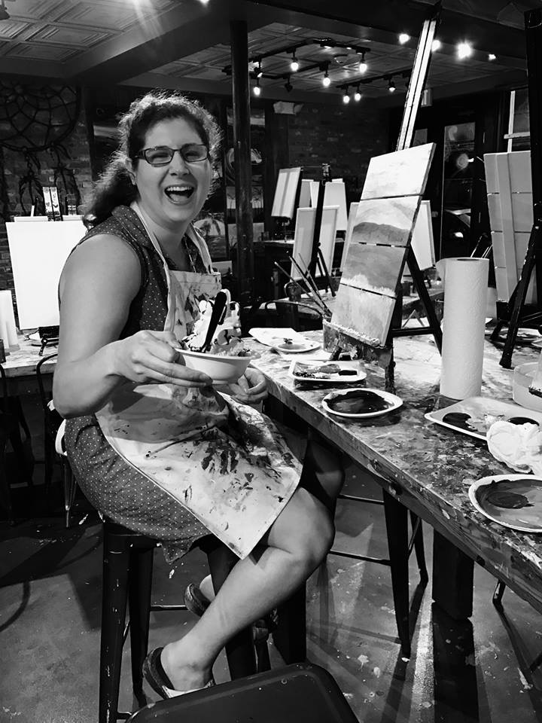
Meet Rachel Rasnick
Owner/Artist
Rachel Rasnick Art

Slide 2
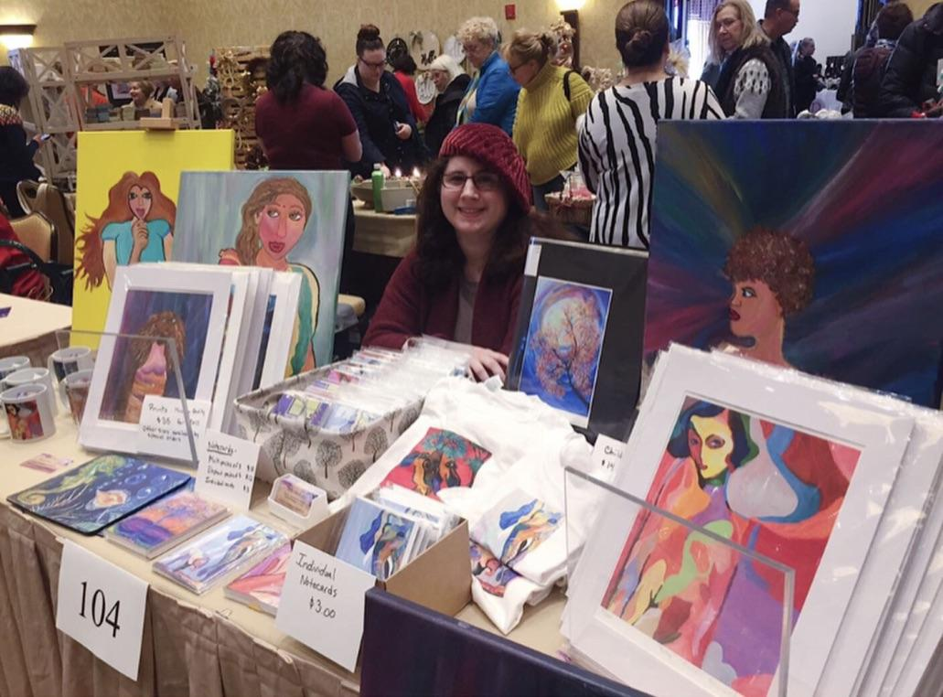
What Is My Business?
I paint animals, landscapes and people with acrylics on canvas
Sell prints, notecards, and gift items of my paintings
Commission paintings
I teach painting classes
I donate a portion of proceeds from my notecards to SORI

Slide 3
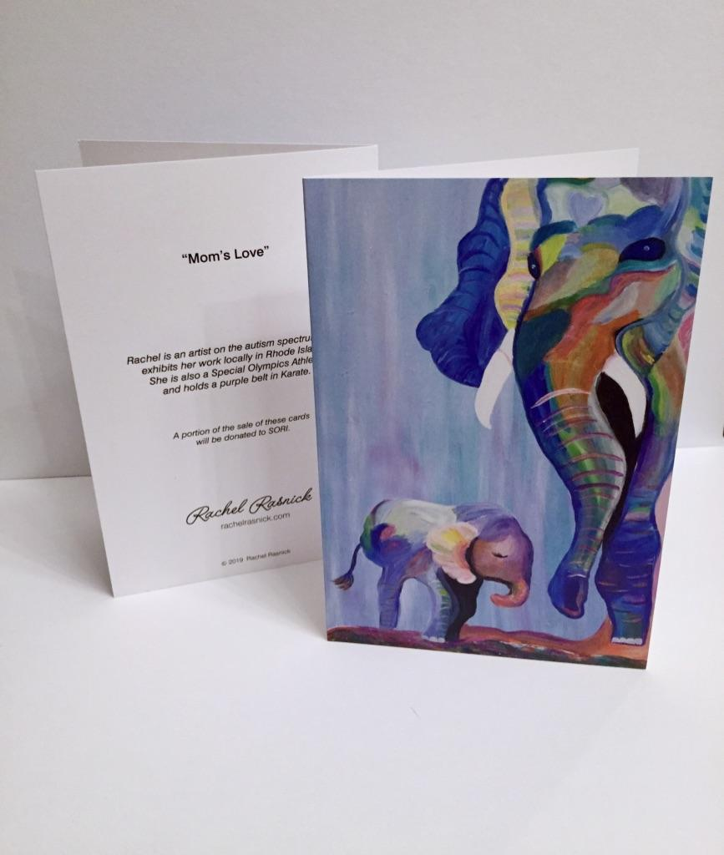
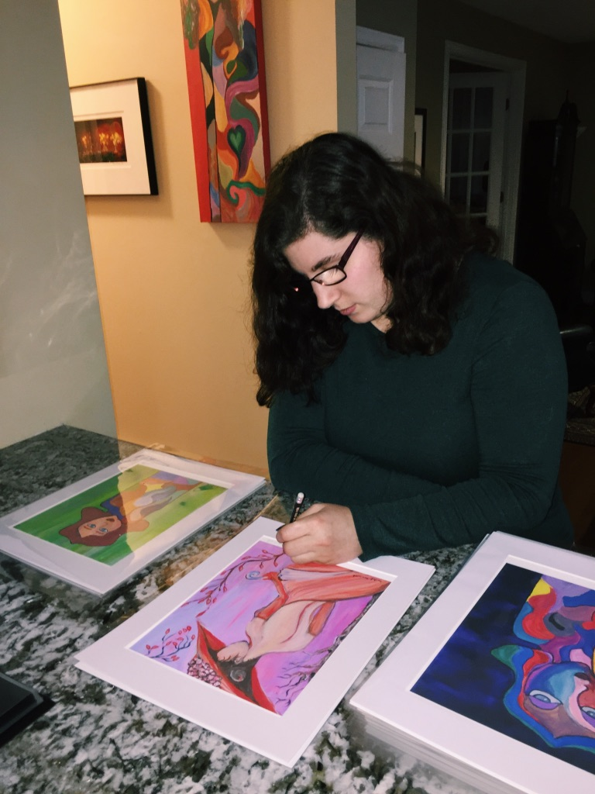
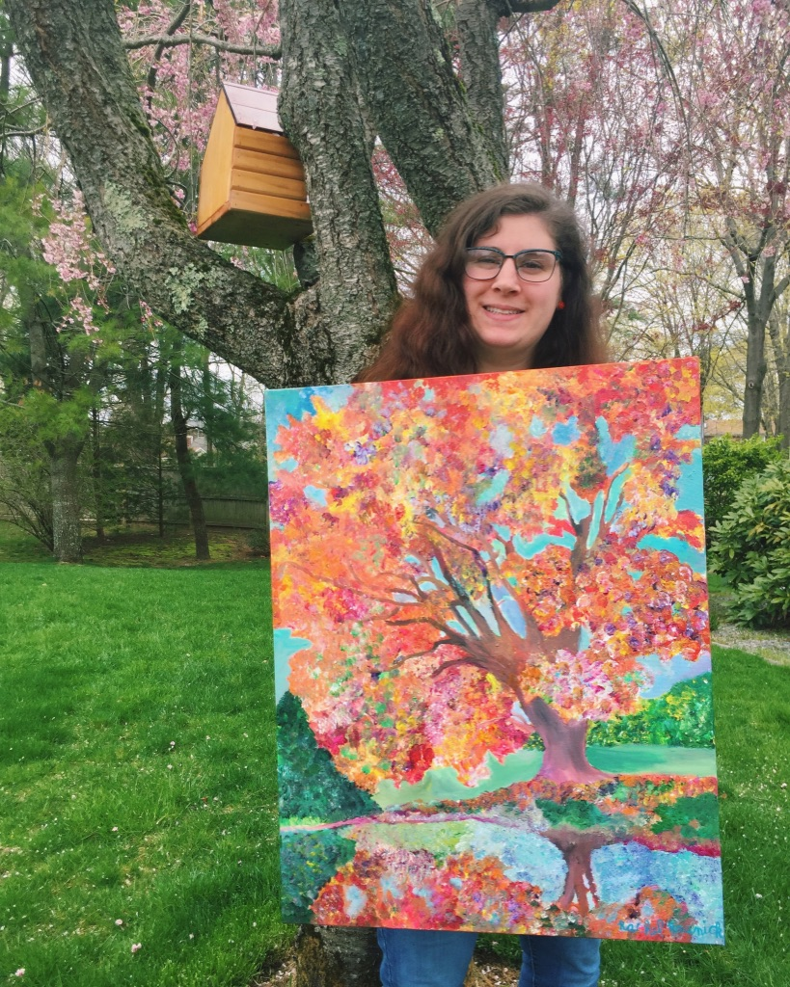
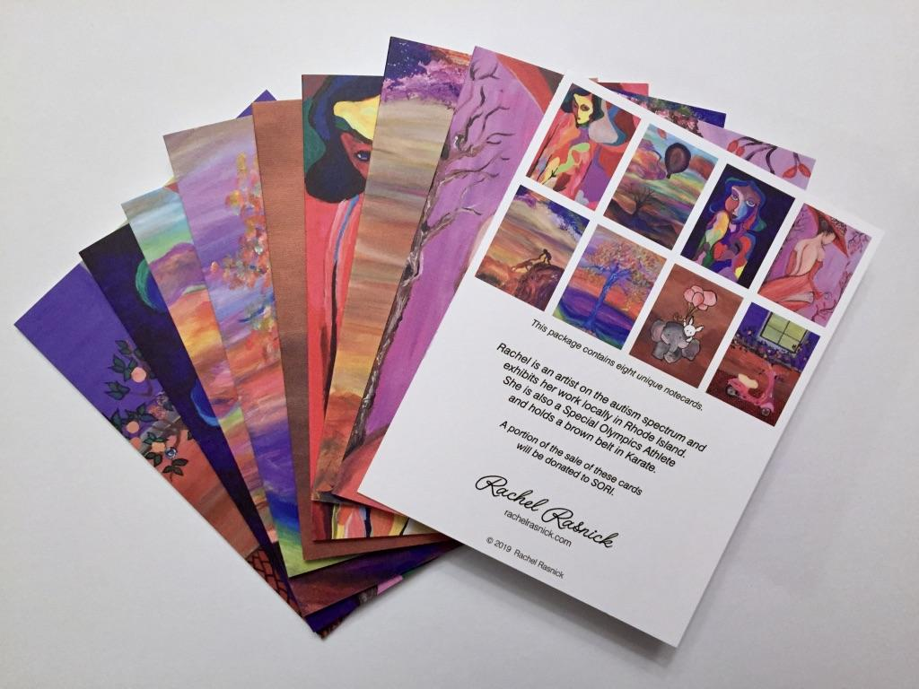
What I Sell:
Signed Prints
Notecards
Original Paintings

Slide 4
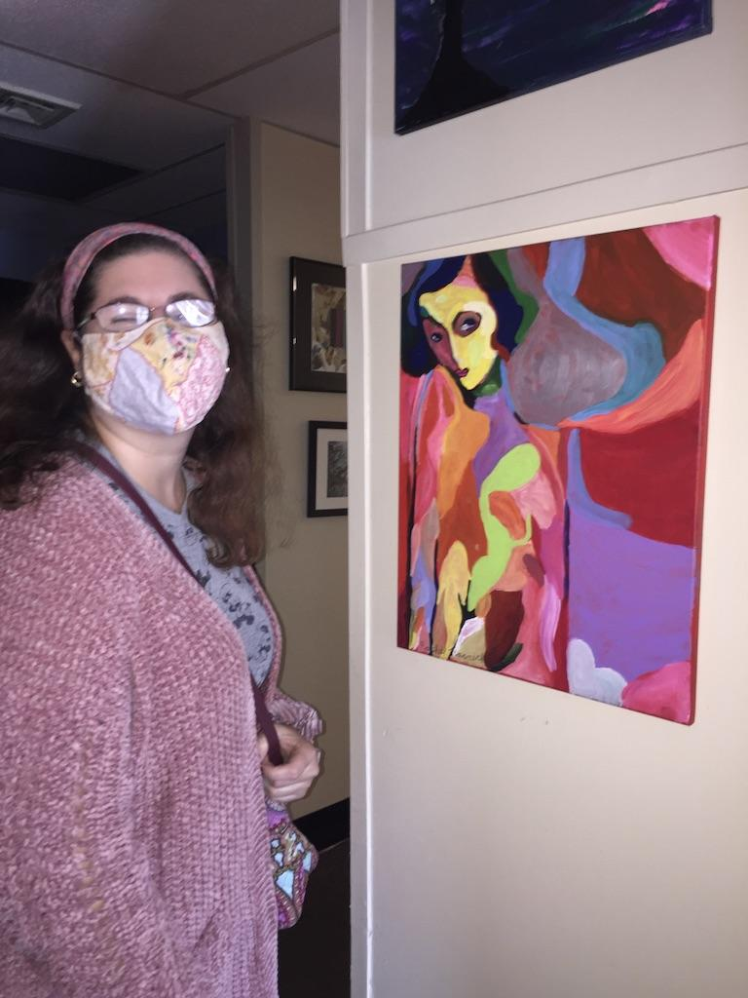
Why I Started My Business
My art was making people happy and I wanted to share it with everyone
A lot of people wanted my paintings, so I started making signed prints to keep up with demand and make my art more affordable
I found something that I was good at and that I loved to do
I decided that I wanted painting to be my full time job and make my own work schedule
My very first painting

Slide 5
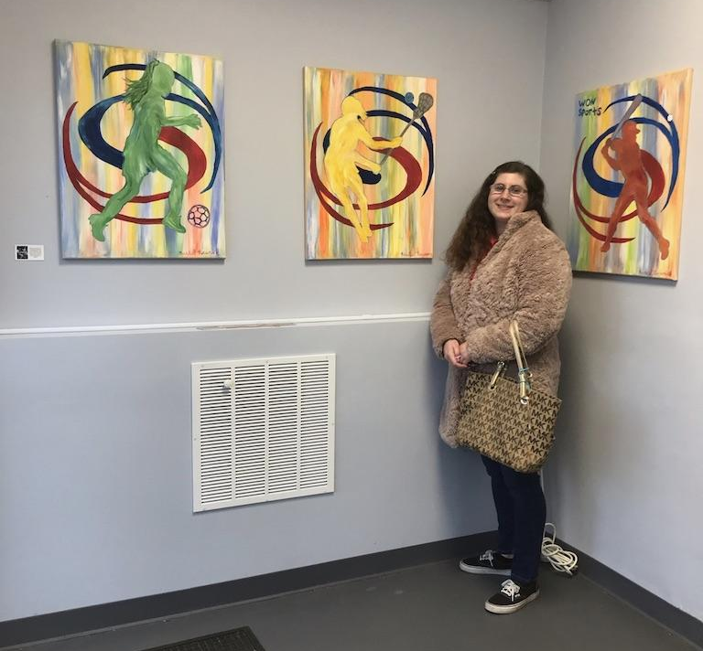
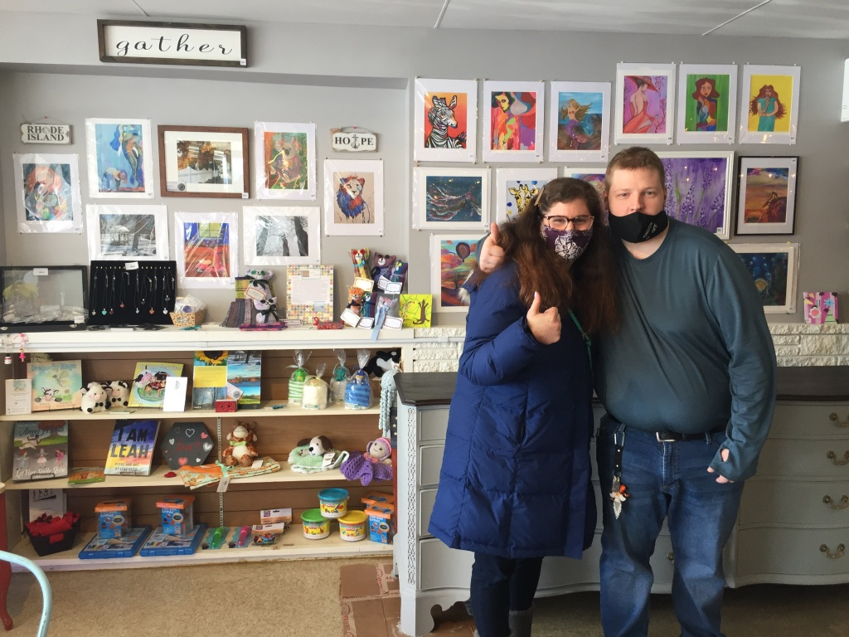
How the Small Business Classes Helped Me
Gave me the confidence to start my own business and showed me I can do anything
Explained things in ways I could understand
Helped my business grow through many networking opportunities:
Small Business Saturday SHOP RI, Newspaper articles, Studio 10 TV Show, Facebook Live w/ Brendan Kirby, commission for Brian LaFauci, exhibiting in coffee shops and galleries throughout RI
I was given a grant that I used towards art supplies, prints of my artwork, notecards, business cards, website
Introduced me to new friends and businesses across the state!

Slide 6
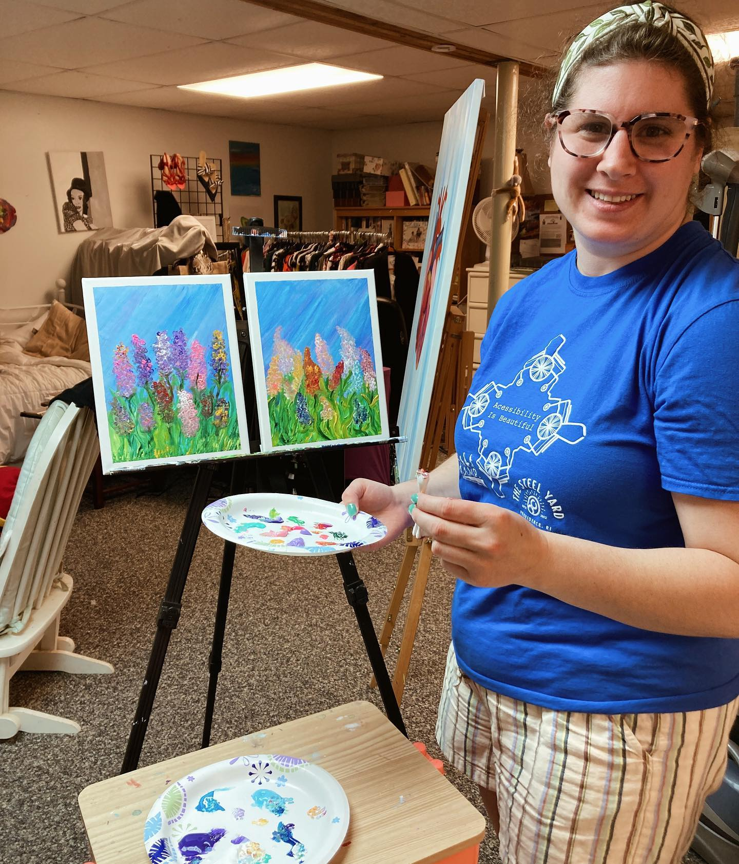
How My Business is Funded/Supported
My family has helped me with promoting my business
I use self-directed supports funded by the State to hire staff to assist me with my business
I use some of my sales profits to put back into my business
I received a few grants (RIDDC, The Fogarty Foundation) to help me with purchasing business supplies
The Outsider Collective organizes Gallery Shows that I participate in to sell my products
The RIDDC pays some of the Vendor Trade Show fees so I can participate
Newspaper/TV Shows helped promote my business so I get new customers
I am a part of the Cross Disability Coalition’s Speakers Bureau and get paid for presentations to talk about my business

Slide 7
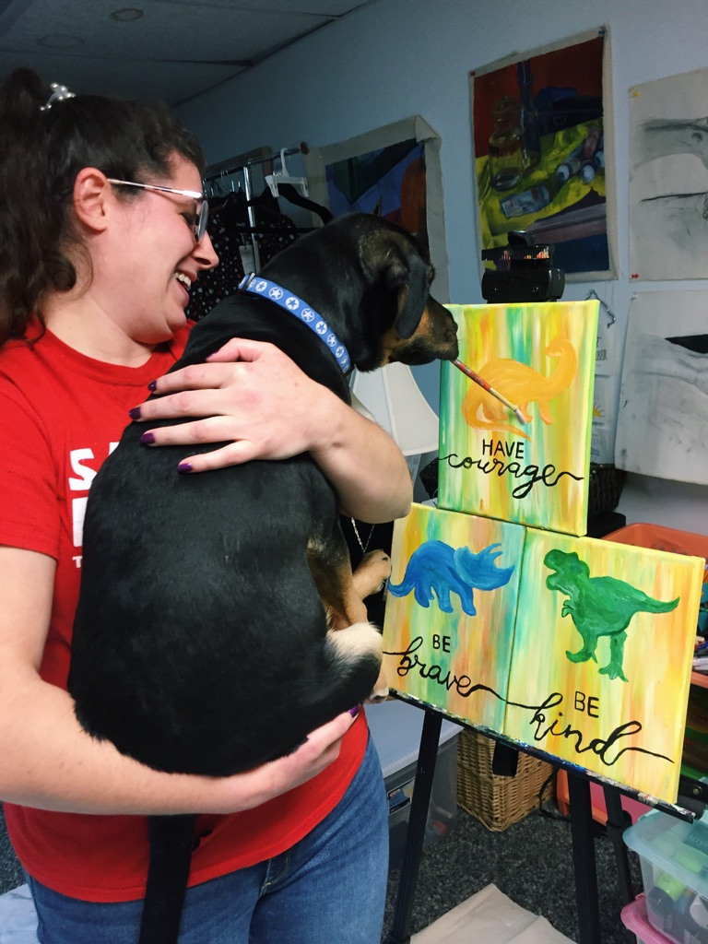
My Advice to Others
Take the business class and complete it all the way through
It will get tough at times, but you just have to keep going because it is worth it!
Ask for help if you need it
Don’t be afraid to reach out to places to sell your products and get your foot in the door
Don’t give up!
Do what you love and have fun!

Slide 8
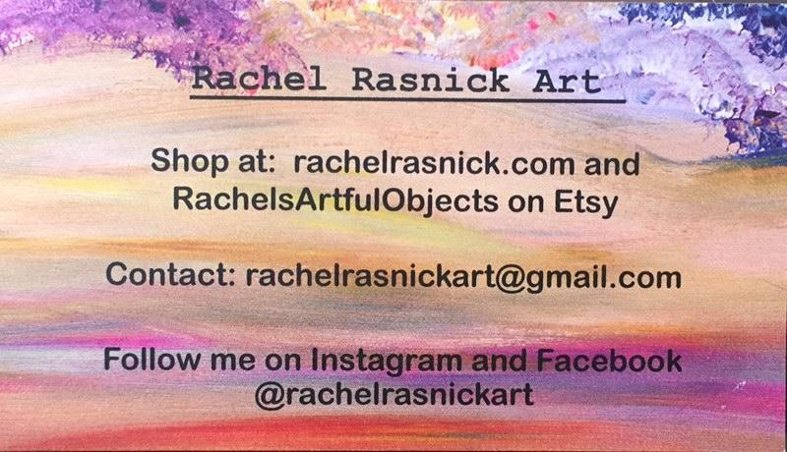
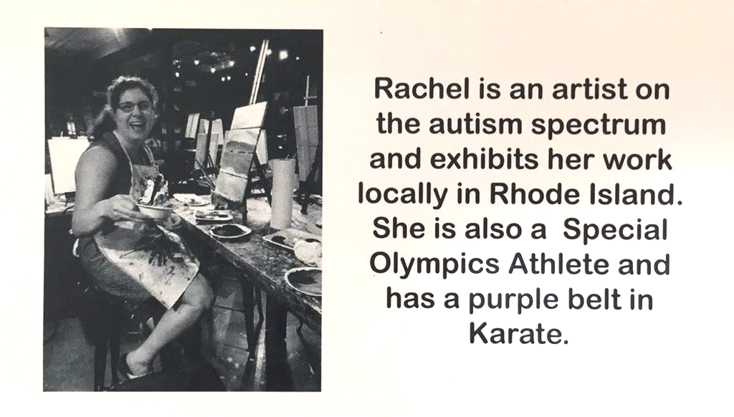
Get in Touch
Phone 401-523-3018
www.rachelrasnick.com/
www.facebook.com/rachelrasnickart
www.instagram.com/rachelrasnickart/

